Slide 1

TARGET FOLDER
SRNTGT074
Apatite West Vehicle Factory, SRN
OPAC CLASSIFIED
REL TO CJTF-23
OPAC CLASSIFIED
REL TO CJTF-23

Slide 2

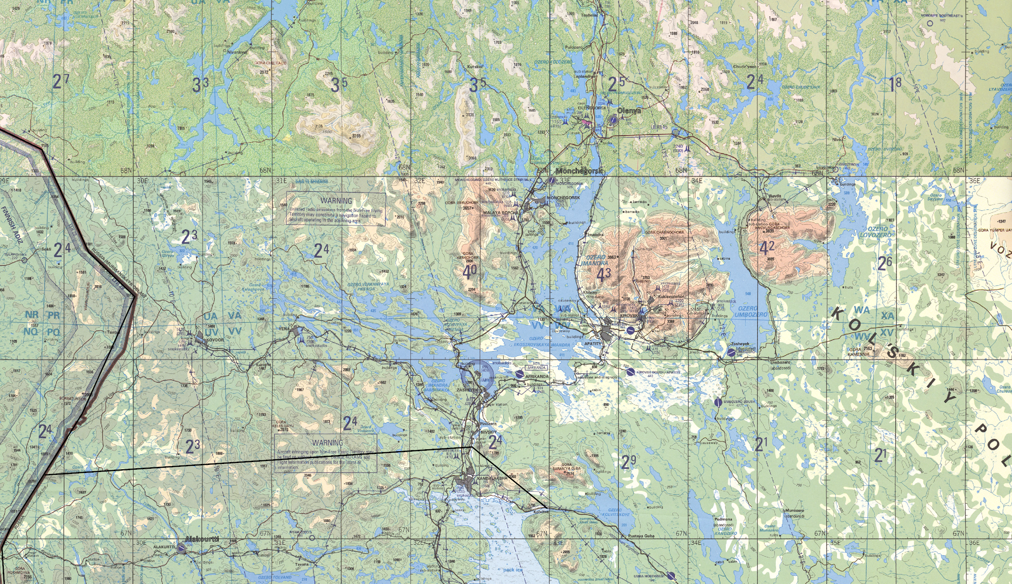
 | Apatite West Vehicle Factory, SRN JOINT OPERATIONS GRAPHIC | MAP OVERVIEW | OPAC CLASSIFIED REL TO CJTF-23
 | BE: SRNTGT074 CATCODE: 9 MIDB GEO: N67 32.700 E033 44.530 ICOD: 2011-07-01 DOI: 2011-05-12 |  | DECL ON: [YYYYMMDD] (+50 YEARS)
OPAC CLASSIFIED
N
Apatite West Vehicle Factory
SRNTGT074
.
OPAC CLASSIFIED
REL TO CJTF-23

Slide 3
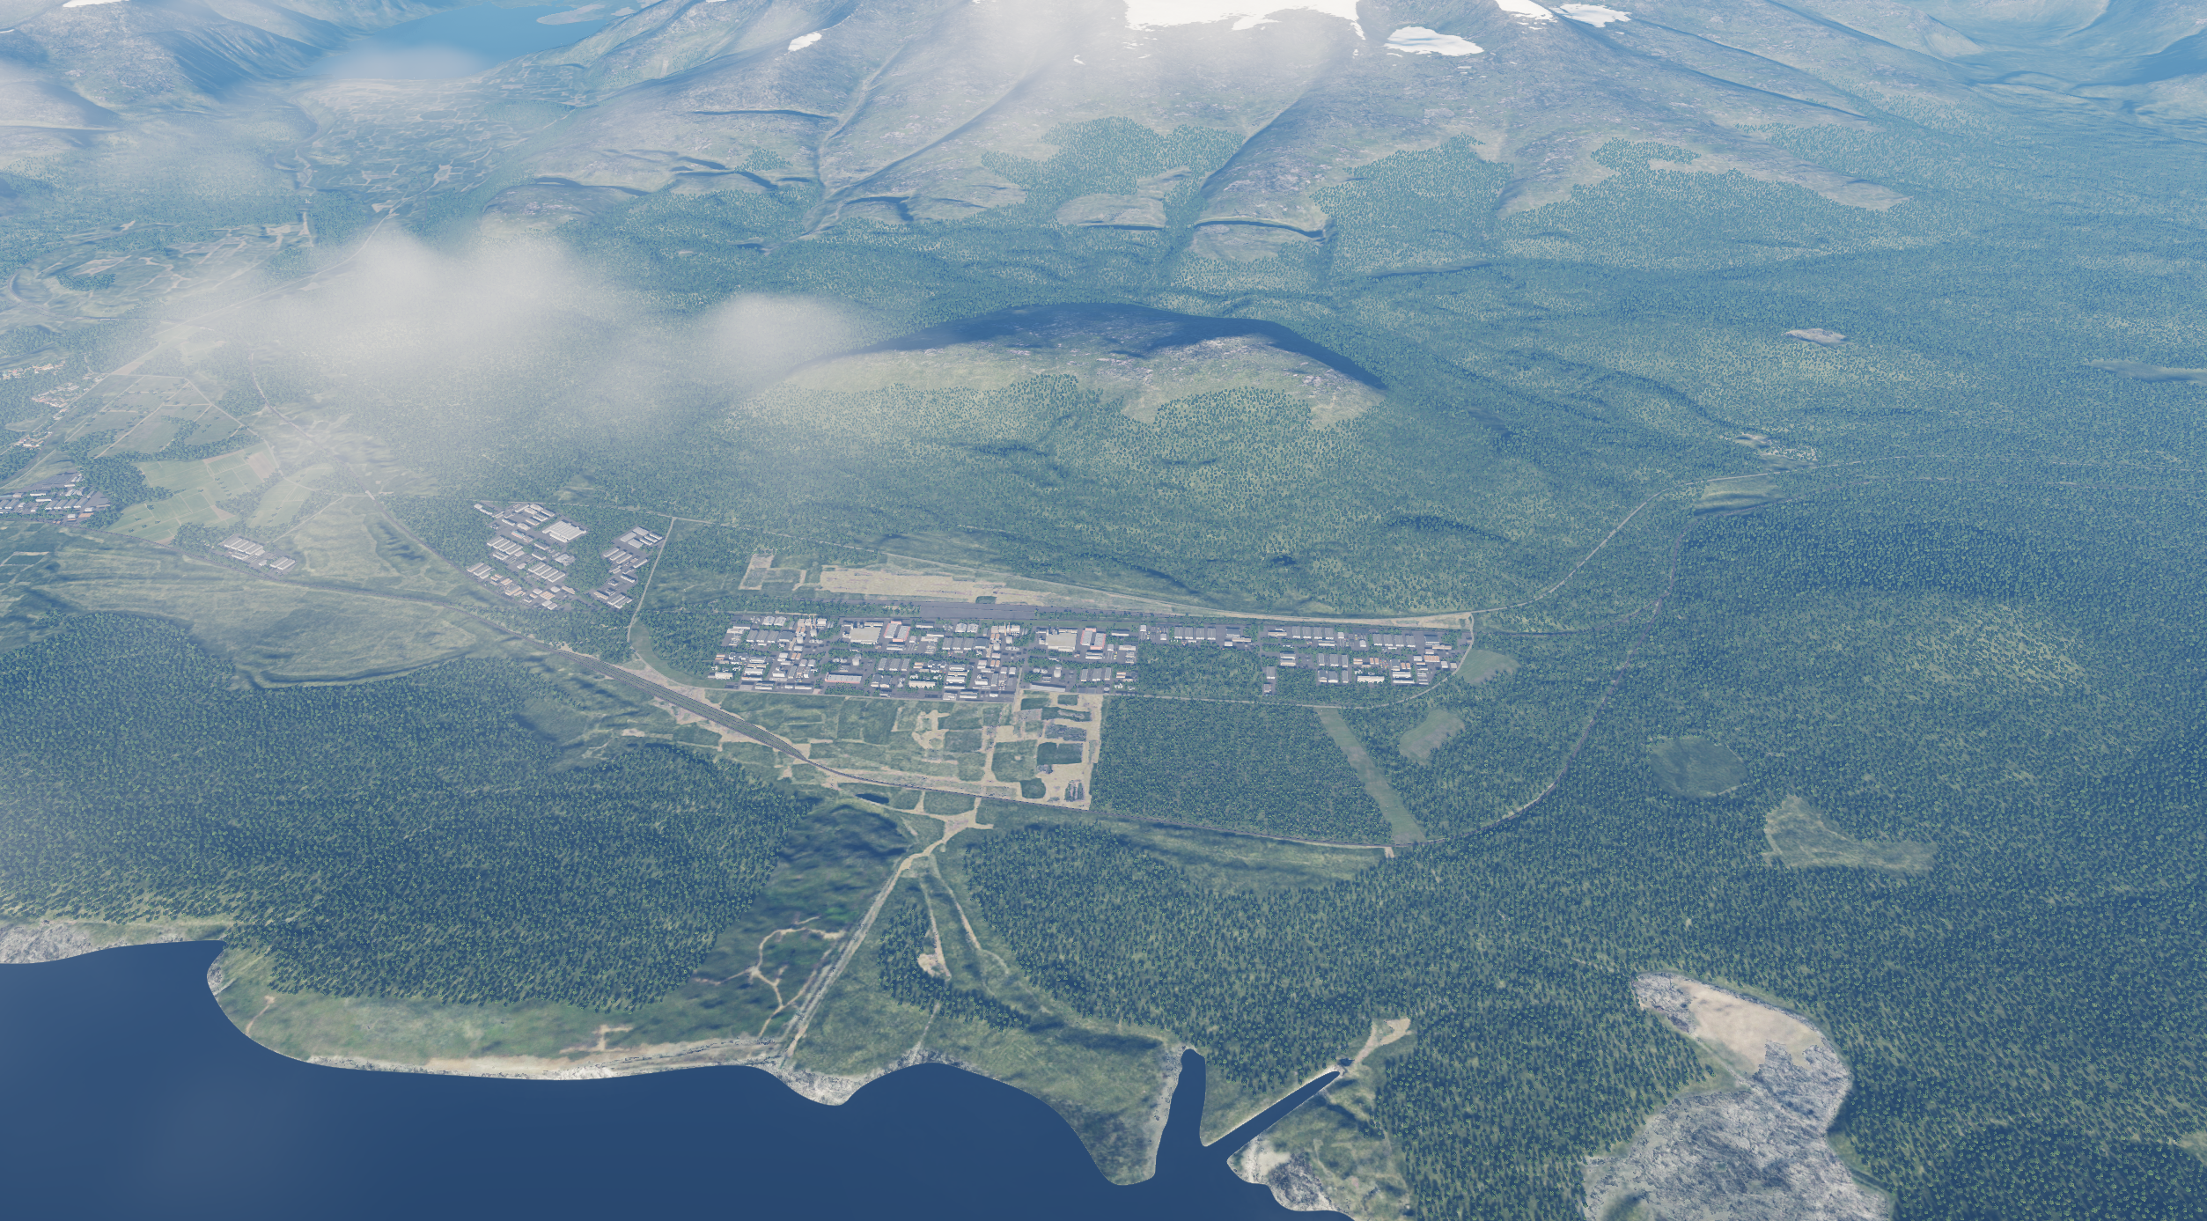
 | Apatite West Vehicle Factory, SRN FACILITY OUTLINE GRAPHIC | MAP OVERVIEW | OPAC CLASSIFIED REL TO CJTF-23
 | BE: SRNTGT074 CATCODE: 9 MIDB GEO: N67 32.700 E033 44.530 ICOD: 2011-07-01 DOI: 2011-05-12 |  | DECL ON: 2061-01-01(+50 YEARS)
OPAC CLASSIFIED
N
OPAC CLASSIFIED
REL TO CJTF-23

Slide 4
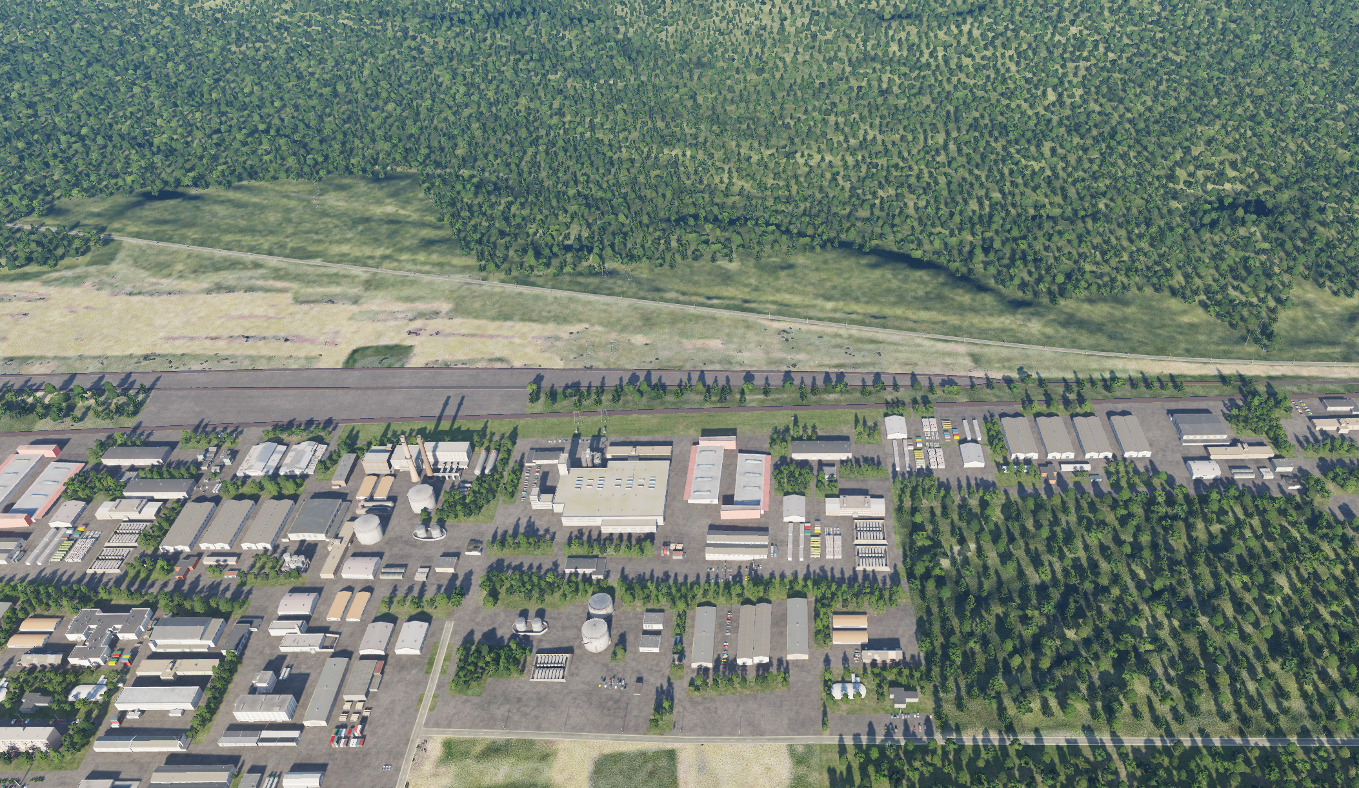
 | Apatite West Vehicle Factory, SRN DESIRED POINT OF IMPACT GRAPHIC | MAP OVERVIEW | OPAC CLASSIFIED REL TO CJTF-23
 | BE: SRNTGT074 CATCODE: 9 MIDB GEO: N67 32.700 E033 44.530 ICOD: 2011-07-01 DOI: 2011-05-12 |  | DECL ON: 2061-01-01(+50 YEARS)
OPAC CLASSIFIED
DPI: SRNTGT074E
GENERATOR BUILDING
N 67 32.722 E 033 44.446
DPI MSL: 909 FT
DPI: SRNTGT074C
PRODUCTION FACILITY
N 67 32.743 E 033 44.586
DPI MSL: 915 FT
N
DPI: SRNTGT074B
PRODUCTION FACILITY
N 67 32.704 E 033 44.667
DPI MSL: 909 FT
DPI: SRNTGT074D
PRODUCTION FACILITY
N 67 32.702 E 033 44.372
DPI MSL: 907 FT
DPI E
DPI C
DPI D
DPI B
DPI: SRNTGT074A
PRODUCTION FACILITY
N 67 32.691 E 033 44.456
DPI MSL: 903 FT
DPI A
DPI: SRNTGT074F
FUEL STORAGE
N 67 32.674 E 033 44.455
DPI MSL: 898 FT
DPI F
DPI G
DPI: SRNTGT074G
FUEL STORAGE
N 67 32.655 E 033 44.438
DPI MSL: 895 FT
OPAC CLASSIFIED
REL TO CJTF-23

Slide 5
 | Apatite West Vehicle Factory, SRN WEAPONEERING OPTIONS | MAP OVERVIEW | OPAC CLASSIFIED REL TO CJTF-23
 | BE: SRNTGT074 CATCODE: 9 MIDB GEO: N67 32.700 E033 44.530 ICOD: 2011-07-01 DOI: 2011-05-12 |  | DECL ON: 2061-01-01(+50 YEARS)
OPAC CLASSIFIED
JPI | DESCRIPTION | TLE | WARHEAD | GUIDANCE | DESIRED EFFECT | IMPACT ANGLE | FUZING
DPI A | Production facility | CAT 1 | 2000Ibs | GPS/Laser | Blast/fragmentation | 60˚-90˚ | 25ms
DPI B | Production facility | CAT 1 | 2000Ibs | GPS/Laser | Blast/fragmentation | 60˚-90˚ | 25ms
DPI C | Production facility | CAT 1 | 2000Ibs | GPS/Laser | Blast/fragmentation | 60˚-90˚ | 25ms
DPI D | Production facility | CAT 1 | 2000Ibs | GPS/Laser | Blast/fragmentation | 60˚-90˚ | 25ms
DPI E | Generator for production facilities | CAT 1 | 2000Ibs | GPS/Laser | Blast/fragmentation | 60˚-90˚ | 10ms
DPI F | Fuel storage for generators | CAT 1 | 2000Ibs | GPS/Laser | Blast/fragmentation | 60˚-90˚ | 10ms
DPI G | Fuel storage for generators | CAT 1 | 2000Ibs | GPS/Laser | Blast/fragmentation | 60˚-90˚ | 10ms
OPAC CLASSIFIED
REL TO CJTF-23
Notes:
Fuze delay.
0 ms = destroy the roof,
10 ms = explode 3 meters below roof, perfect for single storey building,
25 ms = good for all other buildings, explode inside the building.
60 ms for BLU-109 only, for bunkers or more than 20m high buildings.
For all bombs in level bombing, without specific input like impact angle on JDAMs, the higher you drop the bomb, the higher the impact angle. It goes from around 30° at 5000' to 60° at 250000. So basically you for the release profile by indicating the desired angle of impact

Slide 6
 | Apatite West Vehicle Factory, SRN COLLATERAL DAMAGE ESTIMATION GRAPHIC |  | OPAC CLASSIFIED REL TO CJTF-23
 | BE: SRNTGT074 CATCODE: 9 MIDB GEO: N67 32.700 E033 44.530 ICOD: 2011-07-01 DOI:2011-05-12 |  | DECL ON: 2061-01-01(+50 YEARS)
OPAC CLASSIFIED
N
CER 250M / 812ft
DPI D
NCC: Fuel tank
680 FT SW FROM DPI D
OPAC CLASSIFIED
REL TO CJTF-23
CDE 3, PGM, UNITARY
Notes:
Collateral Effect Radius (CER) is based in Risk Estimates Distances.
CER is based on Risk Estimate Distances (listed in SPINS).
CDE 1: Military target (legal military target), no restriction
CDE 2: Structure within CER, but no collateral issue (storage, hut, small construction). No cluster munitions allowed and FAH need to take structure in minde to avoid damage.
CDE 3: Civilian structure within CER (Residential buildings, houses, structures that can cause secondary explosion, such as fuel storages), Precision guided munitons neededl
CDE 4: Civilian structure within CER and likely damaged by attack. Damages minimized by FAH and delayed fuze settings. JFACC approval agency for CDE 4 targets. (AWACS delegated during missions.
CDE 5: Civilian casualites expected, CJTF-HQ approval needed for striking CDE 5 targets.

Slide 7
 | Apatite West Vehicle Factory, SRN COLLATERAL DAMAGES ESTIMATION 1/1 | MAP OVERVIEW | OPAC CLASSIFIED REL TO CJTF-23
 | BE: SRNTGT074 CATCODE: 9 MIDB GEO: N67 32.700 E033 44.530 ICOD: 2011-07-01 DOI: 2011-05-12 |  | DECL ON: 2061-01-01(+50 YEARS)
OPAC CLASSIFIED
COLLATERAL DAMAGES WITHIN A 500M RADIUS
DESCRIPTION |  | CATCODE | MIDB GEOS | LOCATION | REMARKS
Fuel Tank |  | N/A | N/A | 247˚/680ft from DPI D | Storage of fuel, can cause secondary explosions
NO STRIKE ENTITIES WITHIN A 500M RADIUS
NSE ID | DESCRIPTION | CATCODE | MIDB GEOS | LOCATION | REMARKS
OPAC CLASSIFIED
REL TO CJTF-23

Slide 8
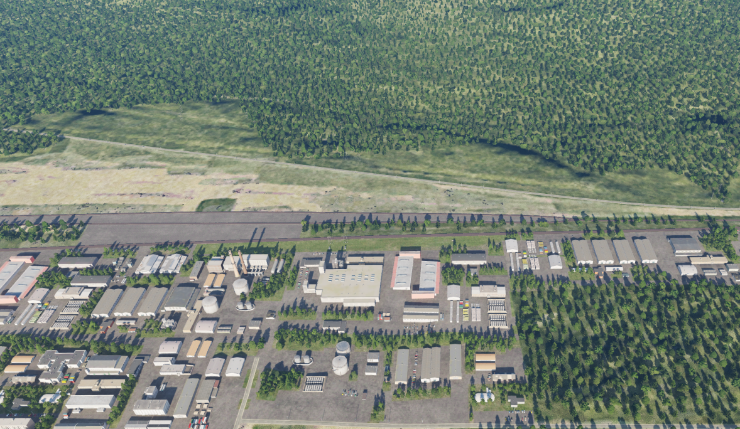
 | Apatite West Vehicle Factory, SRN BATTLE DAMAGE ASSESSMENT GRAPHIC [X] | MAP OVERVIEW | OPAC CLASSIFIED REL TO CJTF-23
 | BE: SRNTGT074 CATCODE: 9 MIDB GEO: N67 32.700 E033 44.530 ICOD: 2011-XX-XX DOI: 2011-XX-XX |  | DECL ON: 2061-01-01(+50 YEARS)
OPAC CLASSIFIED
POST-STRIKE
PRE-STRIKE
N
N
TARGET OBJECTIVE
DAMAGE/CHANGE ASSESSMENT
JDPI:[XXXXXX]
OPAC CLASSIFIED
REL TO CJTF-23
BDA REMARK: [CLASSIFICATION] [DISSEMINATION] Assessment: Physical Damage/change, Collateral Damage, Functional Damage/change, Munitions Effectiveness, Reattack Recommendation, Additional/Collateral Effects

